Slide 1

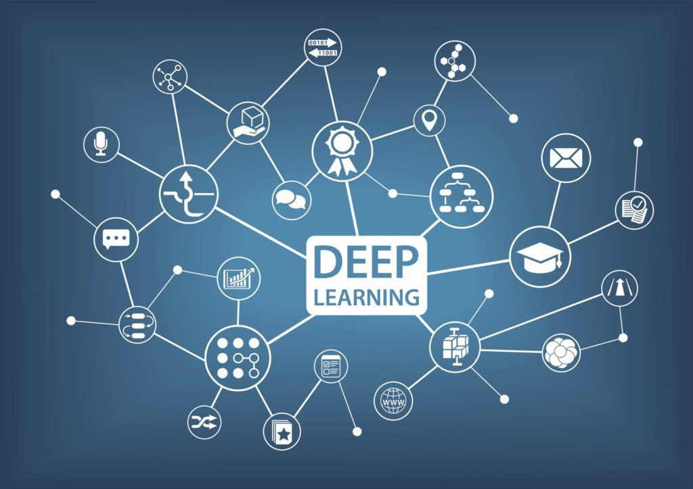

How To Apply Machine Learning Into your Business
12th of June 2019
Notes:
Hello and Thank you all. Olvents and Elza. My name is Juan Pablo I am working as Data Analyst at CBRE in the LIS department. I am very happy of having the opportunity of sharing my experience with you all with automation, Machine learning and statistics in general.

Slide 2
Data augmentation to improve Machine learning Models
Load Data
Patching
and Data Augmentation
Image Segmentation
Train GAN
Test Generated Images
Apply CNN for data categorisation
Notes:
This is the pipeline of our project to improve a our histology classification model.

Slide 3



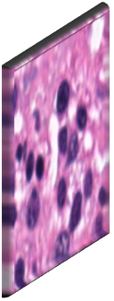
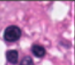
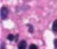

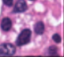
Convolutional neural network (cnn)
Feature maps
Feature maps
Input
Feature maps
Output
Subsampling
Fully Connected
Subsampling
Convolutions
Convolutions
Notes:
Convolutional Neural Networks are the most used method for image classification. This is a very quick explanation of the different phases.

Slide 4





Manual reporting VS automation
Data Analyst - Manual Reporting
Manager | Supervisors
CEO
70 %
Reports
Presentations
Spread Sheets
Reports
Presentations
Meetings
Online Reporting
Notes:
70% 3 people for BAU reporting
Chain of reports…
--iLS Insight--
Eliminate reporting change
Data consolidation
Save time and work: reports, presentations and meetings.
Now we got the time to spend in bringing value to our team through for example ML.

Slide 5



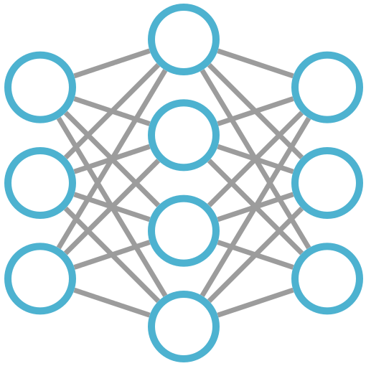
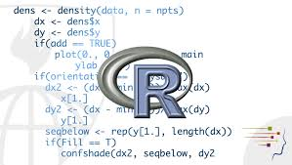


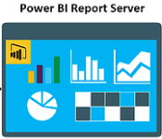




Bau reporting automation + ML
Desktop
Machine Learning
Dashboard, reports...
On-Premise Gateway
Scheduled
refresh
SharePoint
APPs
Notes:
- R and Python script can be imbedded to these report.
And here were or ML works will be implemented from the Power BI Desktop and integrated in our server.

Slide 6
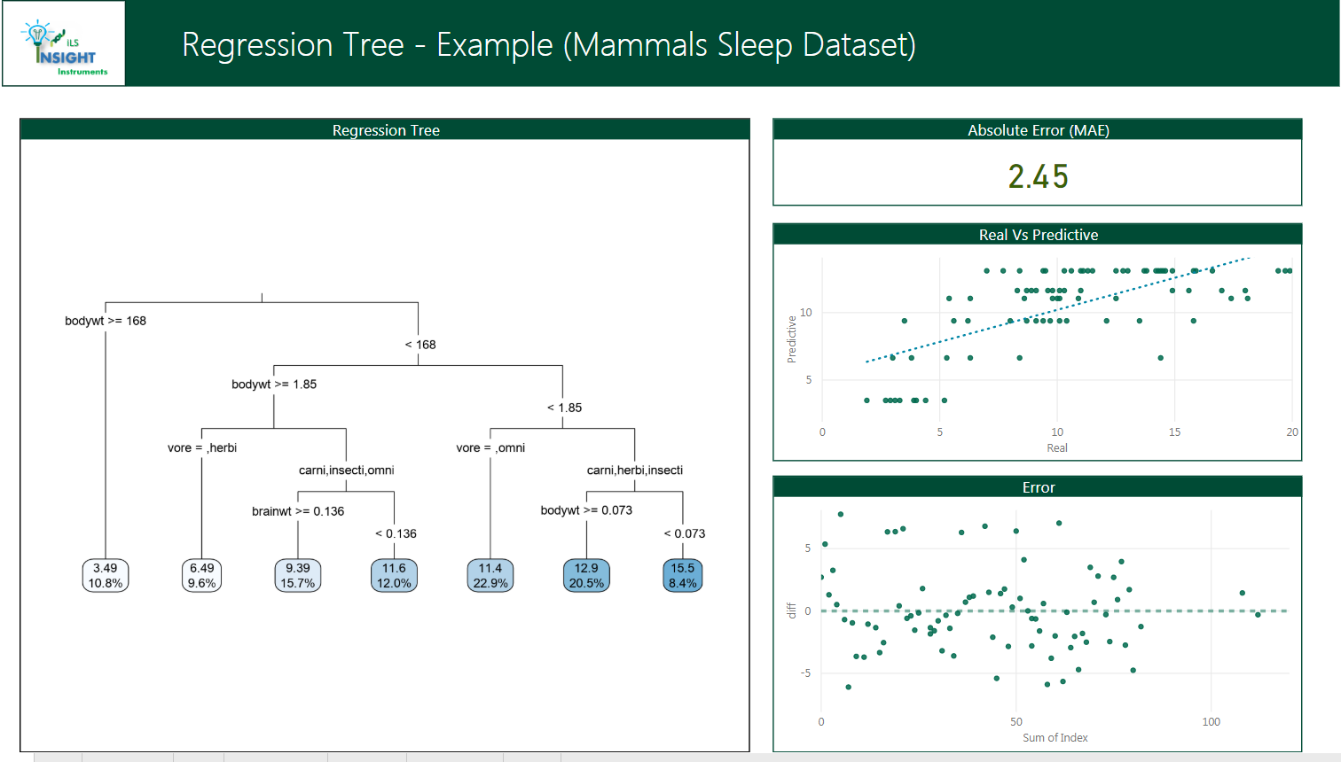
Notes:
Regression Tree: Mammals Sleep time depending on the weight and diet.

Slide 7
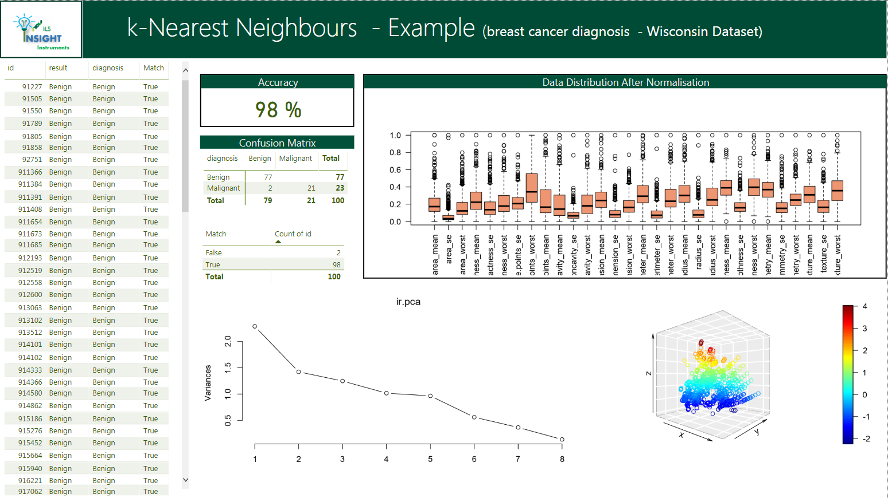

Notes:
K-Nearest Neighbours – non supervise method to classify the data by clusters.

Slide 8
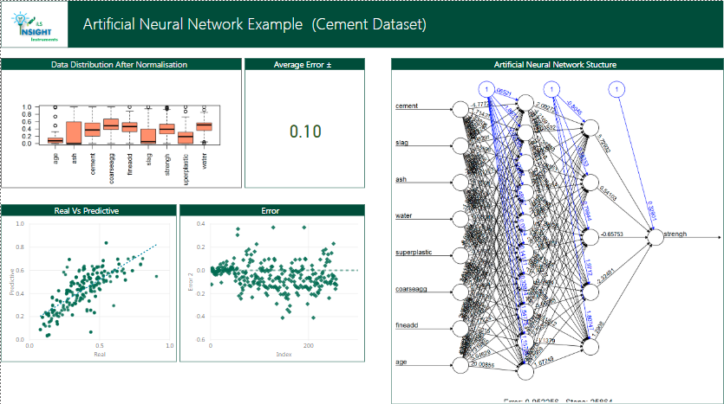
Notes:
Predictive analysis using a simple Artificial Neural Network.

Slide 9
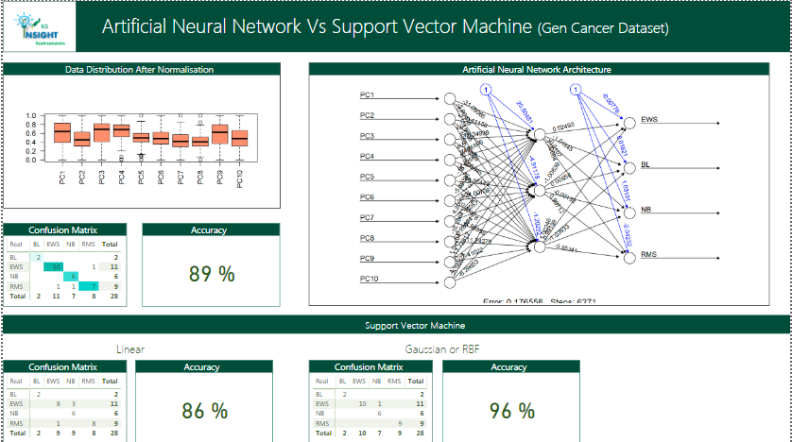
Notes:
ANN for classification, here we can compare in a same report different methods ANN and SVM.

Slide 10
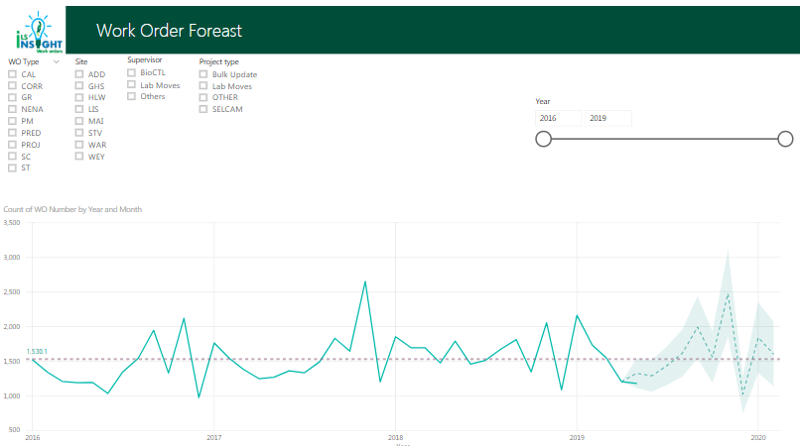
Notes:
In-built function like forecast based in ANN.

Slide 11
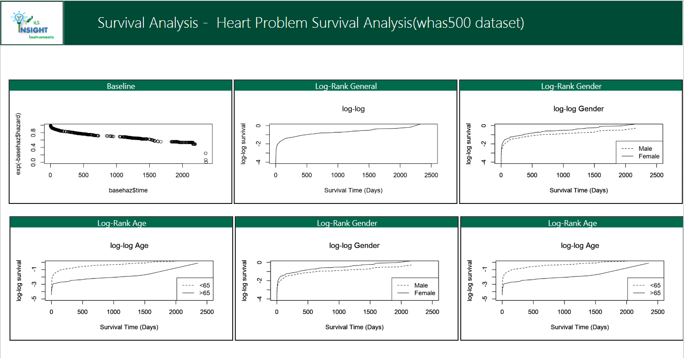
Notes:
Other statistical analysis which are important for us Like survival analysis that is important to us to calculate the MTTF. To predict when a event, in this case a break down, is expected.

Slide 12
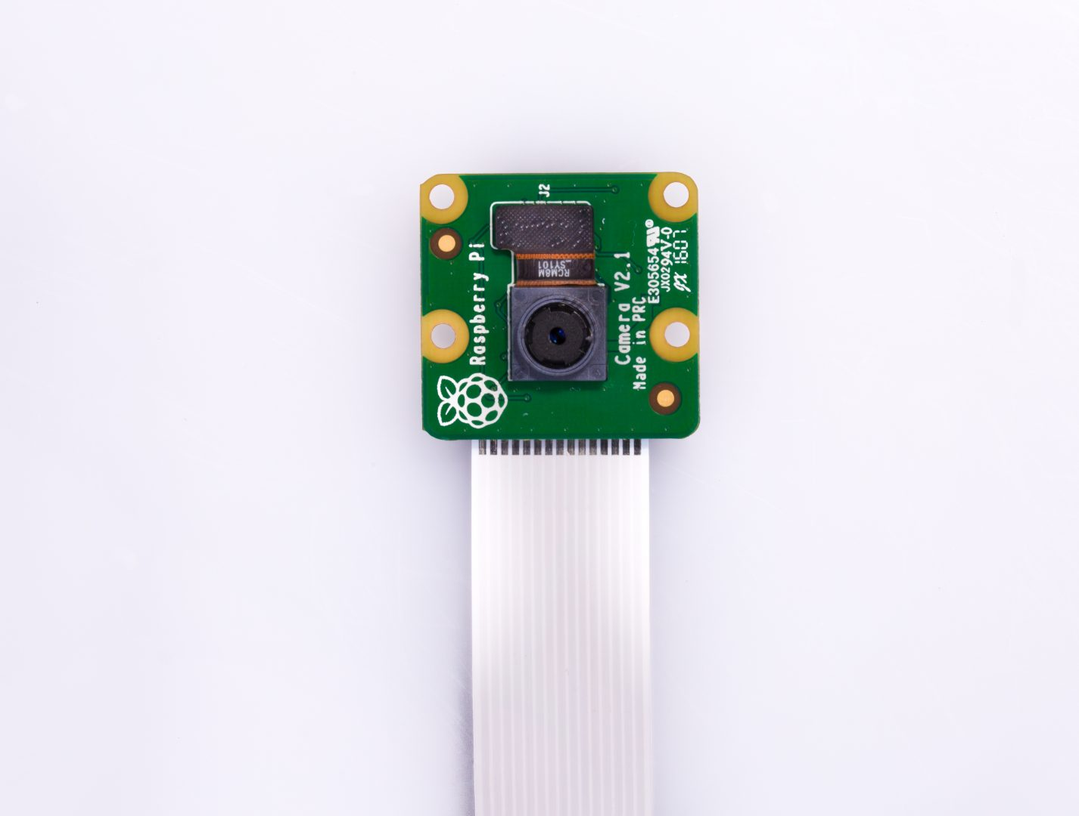
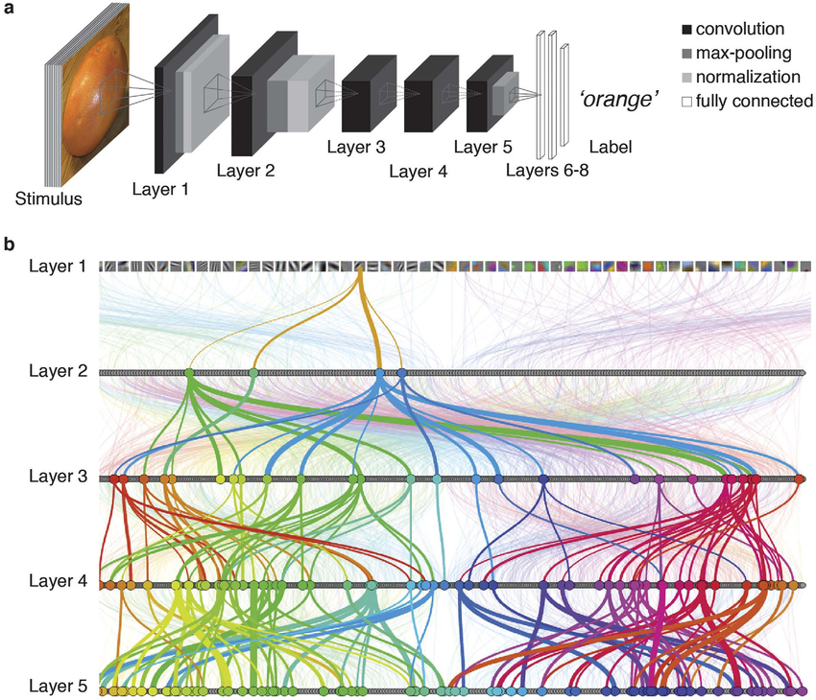
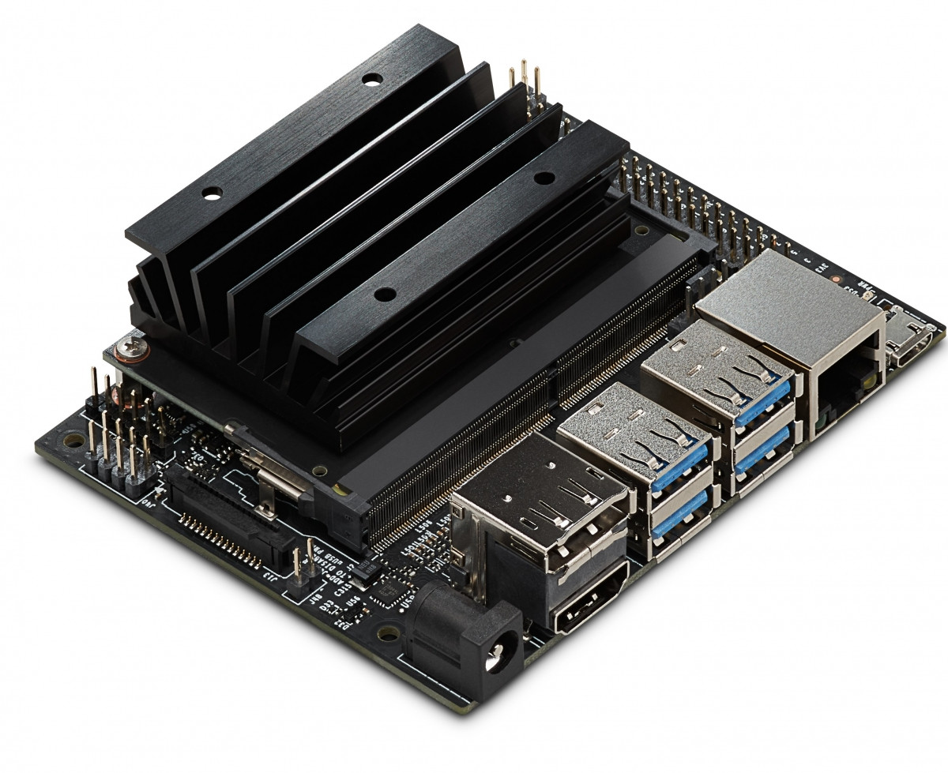
Camera or Sensors
Data Analysis
Images
Temperature
Humidity
Usage
etc
Online Report
Dashboards
Apps
Gateway
Notes:
Gateway for each labs. Compatible with Rasberry Pi

Slide 13
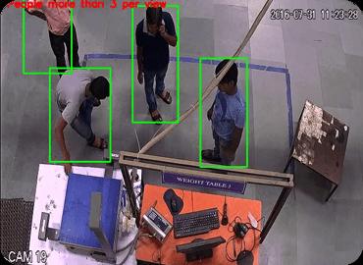
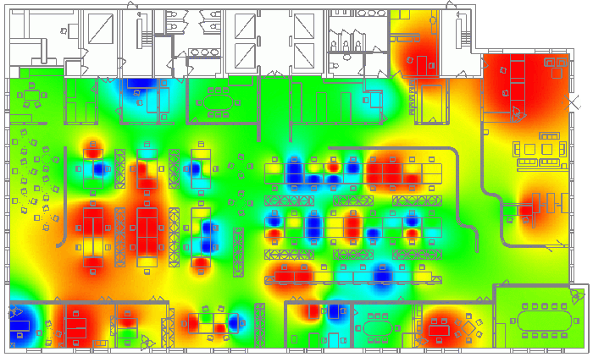
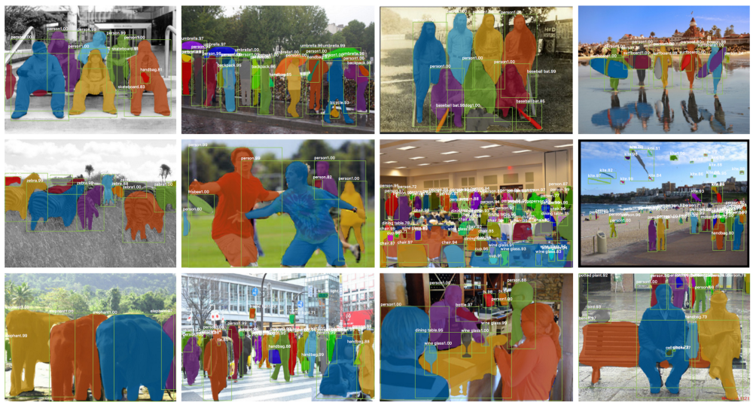


IoT Building Management – Lab Usage

Slide 14
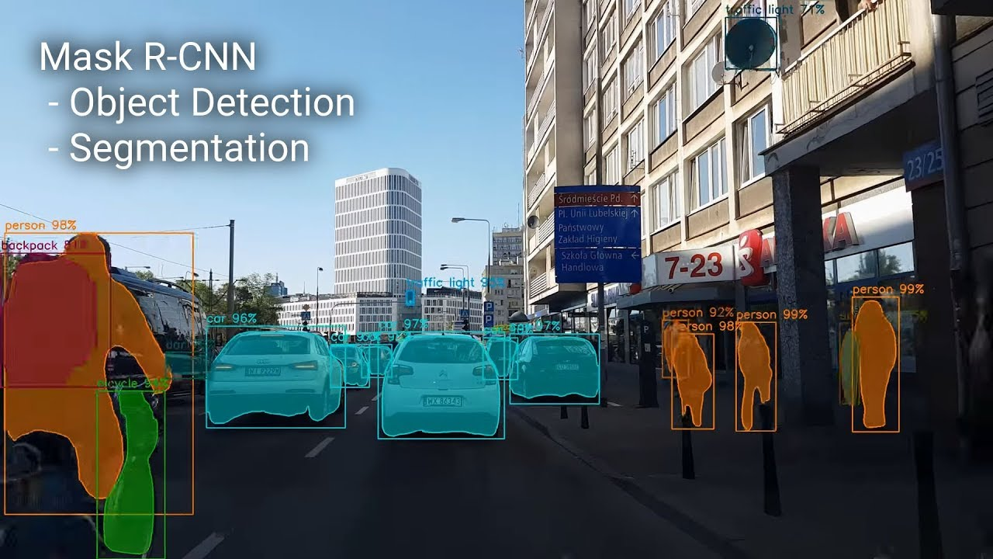
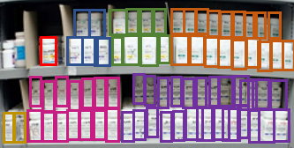
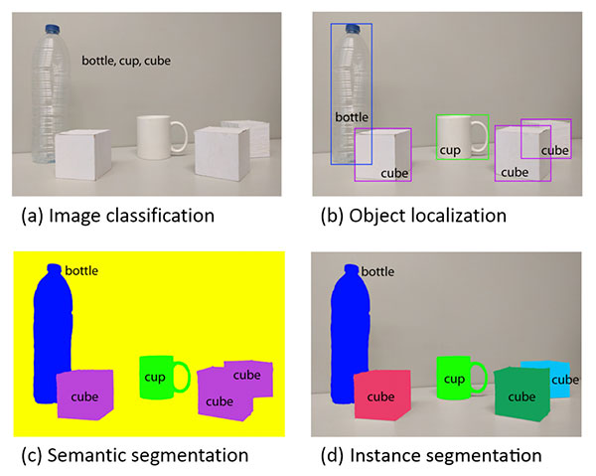
IoT Stock Control – Control Drug

Slide 15
